Slide 1
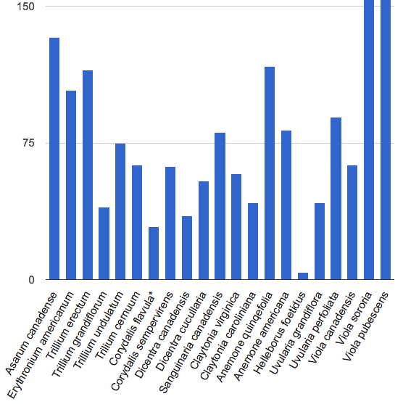
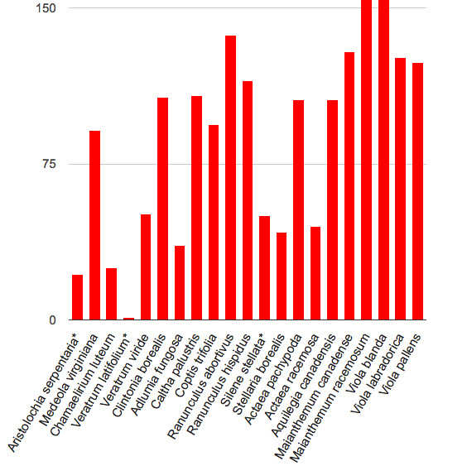
Ant-dispersed plant digital records
Non-ant-dispersed plant digital records

